Slide 1


Data Structures
Week2_Lecture 2
Complexity Analysis
Subhan Ullah, PhD
subhan.ullah@nu.edu.pk
BS(Cybersecurity) Fall-2023

Slide 2
Agenda
Recap
Theoretical analysis of running time of an algorithm
Growth rate of an algorithm

Slide 3
Example

Slide 4
Computer program (example)
int arrayMax (int A[], int n) {
int i;
int currentMax =A[0];
for (i=1;i<n;)
if(A[i]>currentMax)
currentMax=A[i];
i = i+1;
return currentMax;
}

Slide 5

Running Time (simple way)
To simplify the process, the running time is calculated on the basis of every statement instead of primitive operations involved in each expression.
Because every statement $i$is executed in a constant time $C_{i}$ each time
The impact of number of operations in each statement is therefore constant is negligible (Example: simple loop)

Slide 6
Example (simple if-Statement)

Slide 7

Example (Nested Loop)

Slide 8
Constant Factors
An algorithm’s proportional time requirement is known as Growth Rate. We can compare the efficiency of two algorithms by comparing their Growth Rates only
To find growth rate we will look only at the leading term of the running time.
We get the growth rate from T(N) by
Consider all variables which are provided as input:
Dropping lower-order terms.
By ignoring the constant coefficient in the leading term.
Example: 10⁵n²+ 10⁸n becomes n²
The growth rate is not affected for large n by constant factors and lower-order terms

Slide 9
Example
The growth rate is not affected by
Constant factors or
Lower-order terms
Examples
10²n + 10⁵ is a linear function
10⁵n² + 10⁸n is a quadratic function

Slide 10
Analyzing an Algorithm – Growth Rate
Estimated running time for different values of n: using the complexity function of our algorithm: T(n) = 5n +4
n = 10 => 54 steps
n = 100 => 504 steps
n = 1,000 => 5004 steps
n = 1,000,000 => 5,000,004 steps
As n grows, number of steps T(n) grow in linear proportion to n
This represents the very basics of Algorithm analysis.

Slide 11
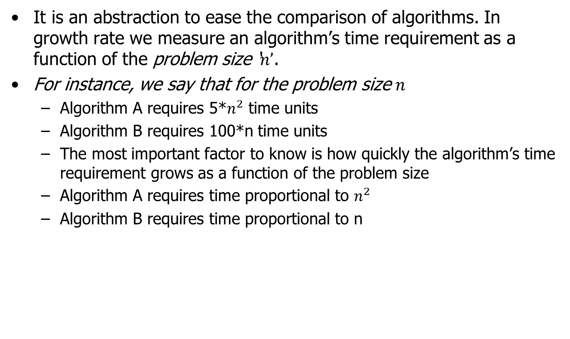
Order of Growth: (Growth Rate)
It is an abstraction to ease the comparison of algorithms. In growth rate we measure an algorithm’s time requirement as a function of the problem size ‘$n’$.
For instance, we say that for the problem size $n$
Algorithm A requires 5*$n^{2}$ time units
Algorithm B requires 100*n time units
The most important factor to know is how quickly the algorithm’s time requirement grows as a function of the problem size
Algorithm A requires time proportional to $n^{2}$
Algorithm B requires time proportional to n

Slide 12
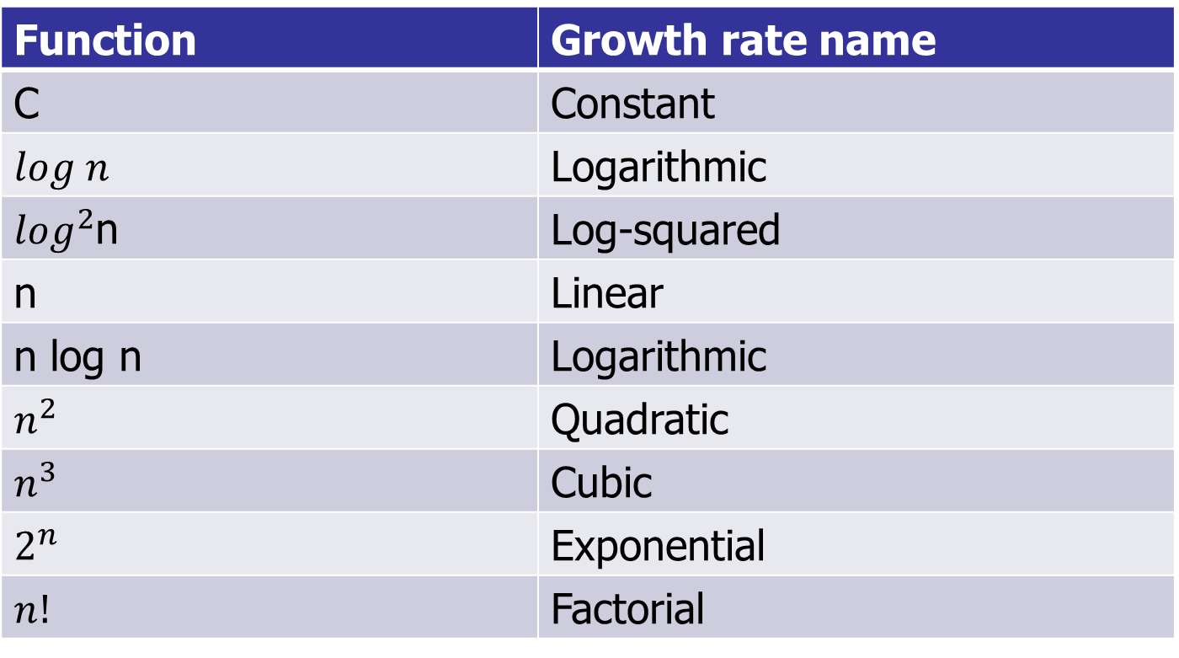
Common Growth rates
Function | Growth rate name
C | Constant
$$log n$$ | Logarithmic
$\log^{2}$n | Log-squared
n | Linear
n log n | Logarithmic
$$n^{2}$$ | Quadratic
$$n^{3}$$ | Cubic
$$2^{n}$$ | Exponential
$$n!$$ | Factorial

Slide 13




Running time for small inputs
$$N^{2}$$
$$N^{3}$$
$O(N log⁡N$)
$$N$$

Slide 14
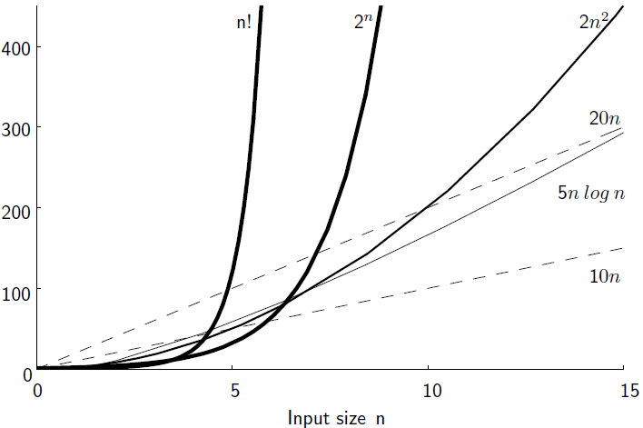
Growth Rate (more examples)

Slide 15
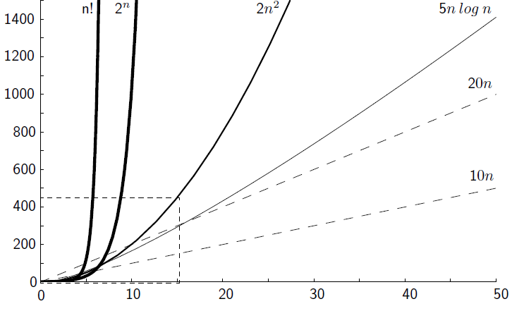
Growth Rate (big input)

Slide 16
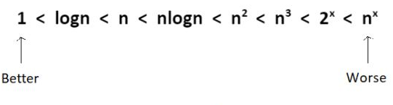
Common runtime from better to worse

Slide 17
Growth Rate
Changing the hardware/software environment
Affects T(n) by a constant factor, but
Does not alter the growth rate of T(n)
Thus we focus on the big-picture which is the growth rate of an algorithm
The linear growth rate of the running time T(n) is an intrinsic property of algorithm for sumArray

Slide 18
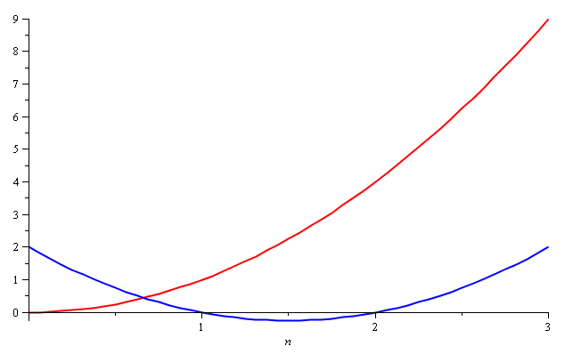
Growth Rate – Example
Consider the two functions
f(n) = n²
g(n) = n² – 3n + 2
Around n = 0, they look very different

Slide 19
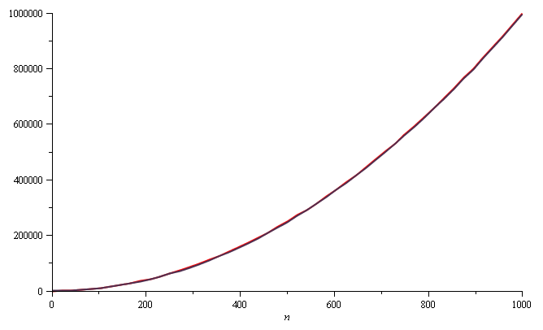
Growth Rate – Example
Yet on the range n = [0, 1000], f(n) and g(n) are (relatively) indistinguishable
f(n) = n²
g(n) = n² – 3n + 2

Slide 20
Growth Rate – Example
The absolute difference is large, for example,
f(1000) = 1 000 000
g(1000) = 997 002
But the relative difference is very small
The difference goes to zero as n → ∞

Slide 21
Constant Factors
The growth rate is not affected by
Constant factors or
Lower-order terms (non-dominating orders)
Examples
10²n + 10⁵ is a linear function
10⁵n² + 10⁸n is a quadratic function
How do we get rid of the constant factors to focus on the essential part of the running time?
Asymptotic Analysis

Slide 22
Final Notes
Even though in this course we focus on the asymptotic growth using big-Oh notation, practitioners do care about constant factors occasionally
Suppose we have 2 algorithms
Algorithm A has running time 30000n
Algorithm B has running time 3n2
Asymptotically, algorithm A is better than algorithm B
However, if the problem size you deal with is always less than 10000, then the quadratic one is faster
Running time
A
B
10000
problem size
Notes:
Asymptotic analysis is a powerful tool, but wield it wisely.
Big O ignores constants, but sometimes the constants matter. If we have a script that takes 5 hours to run, an optimization that divides the runtime by 5 might not affect big O, but it still saves you 4 hours of waiting.
Beware of premature optimization. Sometimes optimizing time or space negatively impacts readability or coding time. For a young startup it might be more important to write code that's easy to ship quickly or easy to understand later, even if this means it's less time and space efficient than it could be.
But that doesn't mean startups don't care about big O analysis. A great engineer (startup or otherwise) knows how to strike the right balance between runtime, space, implementation time, maintainability, and readability.
You should develop the skill to see time and space optimizations, as well as the wisdom to judge if those optimizations are worthwhile
Source: https://www.interviewcake.com/article/javascript/big-o-notation-time-and-space-complexity?

Slide 23
Upper Bound – Big-Oh Notation
Indicates the upper or highest growth rate that the algorithm can have
Ignore constant factors and lower order terms
Focus on main components of a function which affect its growth
Notes:
Intuitively, this means that f does not grow faster than g.

Slide 24
Analyzing an Algorithm
Simple Assignment
a = b
O(1)
Simple loops
for(i=0; i<n; i++) { s; }
O(n)
Nested loops
for(i=0; i<n; i++)
for(j=0; j<n; j++) { s; }
O(n²)

Slide 25
Big Oh Exercise
You lost your wedding ring on the beach, and have no memory of when it came off. Thus, you decide to do a brute force grid search with your metal detector, where you divide the beach into strips, and walk down every strip, scanning the whole beach, until you find it. For simplicity, assume the beach is a square of side length ll meters, each of your strips has a constant width of 1 meter, and it takes 10 seconds to walk 1 meter (it's hard to walk while searching). Find the big-oh performance of your ring finding algorithm.
Notes:
Solution: The beach has size l×l. Since you divide it into strips of width 1 meter, you have l strips, each of length l meters. Thus it takes 10l seconds to check each strip, and 10l^2 seconds to check the entire beach (plus some time taken to move to the next strip, but it shouldn't be very relevant). Thus our algorithm takes about 10l^2 seconds, which we can simplify with big-oh notation to O(l^2).
Source: https://brilliant.org/wiki/big-o-notation/

Slide 26
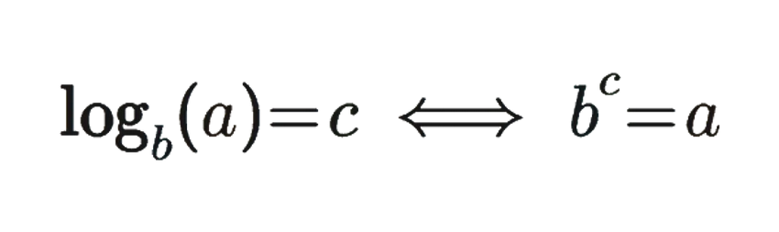
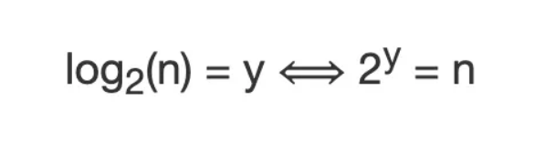
Analyzing an Algorithm
Loop index doesn’t vary linearly
h = 1; while ( h <= n ) { s; h = 2 * h;
}
h takes values 1, 2, 4, … until it exceeds n
There are 1 + log₂n iterations
O(log₂ n)
Example: Log₂8=3
⇒ ₂3=8
Notes:
Basically the loop index forms a geometric series here. 1, 2, 4, 8, 16; with a=1 and r = 2.
We need to figure out how many times the loop will run. The loop will run until the I’th term in the series becomes >=n. Let’s simplify it to = n.
So what is the l’th term in a geometric series? a(r^(i-1)). So for this sequence, that works out to be 2^(i-1).
So, we need to find out the value of i at which 2^(i-1) = n. Taking log on both sides to get the power down, we get log2.(2^(i-1) ) = log2.n. Which works out to be i = log2.n + 1
Generally, the complexity would still be log n if h was being multiplied by ANY factor. (Do one or two examples). It would just be log base that factor, e.g. if it was h = 4*h, our complexity would be log4.n.
HOWEVER. In Big O we don’t mention the base of the logarithm; it is unncecessary as they differ only by a constant factor (for proof, try converting log4.n to log2, it will only be log2.n / log 2(4)). ALL logarithms, regardless of base, grow at the same rate.
Whenever loop index jumps by a MULTIPLICATIVE factor, complexity is log.n. If it jumps by an additive factor, the complexity is linear, or O(n), again because we ignore constants and look at growth RATE.
The other case of logarithmic complexity is when your problem reduces by a multiplicative factor at every step. E.g. the case of binary search in an array. We will see that when we study binary search.

Slide 27
Analyzing Loops index
Loop index depends on outer loop index
for(j=0;j<=n;j++)
for(k=0;k<j;k++){ s; }
Inner loop executed 0, 1, 2, 3, …., n times
O(n²)
n
n(n+1)
Σ i =
i=1
2
Notes:
Inner loop is an arithmetic series. To calculate how many times it will run, we basically calculate the sum of the series. Which is:
S = n⁄2 {2a + (n − 1) d}

Slide 28
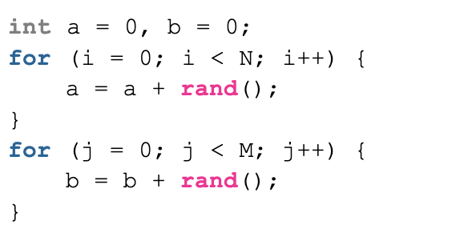
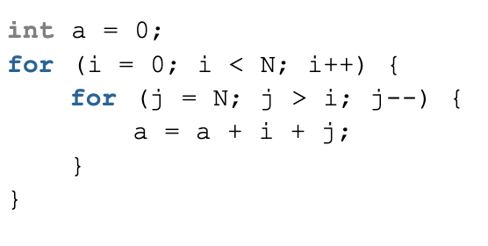
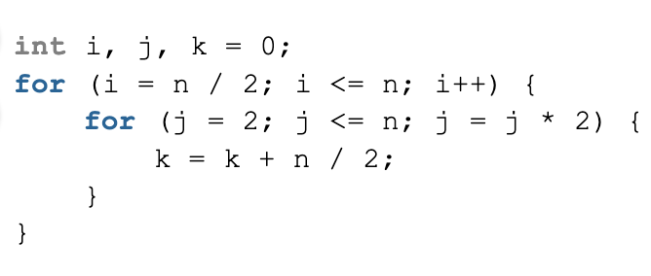

Exercises in Time Complexity Analysis
O(N+M)
O($N^{2}$)
O(NlogN)
Notes:
O(N+M)
O(N^2)
O(NlogN)

Slide 29
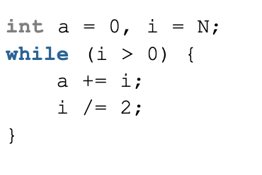
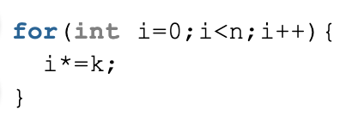
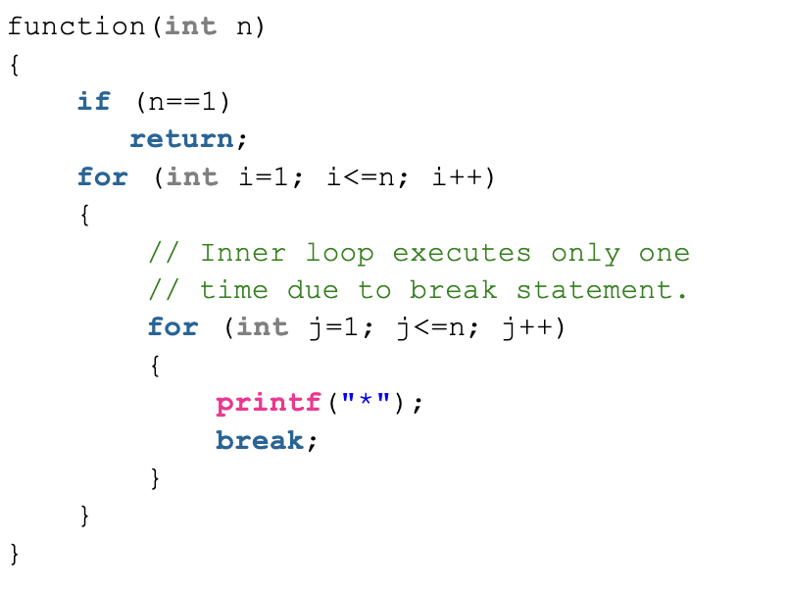
Exercises in Time Complexity Analysis
O(logN)
O(log.K(N))
O(N)
Notes:
1.O(logN)
2.O(log.K(N))
3. O(N)

Slide 30
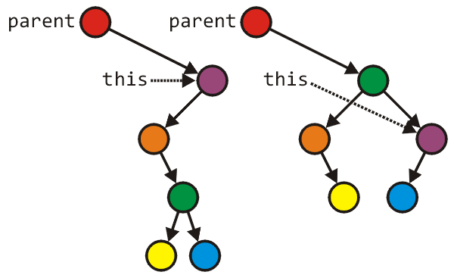
Analyzing an Algorithm – Blocks of Operations
Each operation runs in a step of 1 time unit
Therefore any fixed number of operations also run in 1 time step
s1; s2; …. ; sk
As long as number of operations k is constant
Tree_node *lrl = left->right->left;
Tree_node *lrr = left->right->right;
parent = left->right;
parent->left = left;
parent->right = this;
left->right = lrl;
left = lrr;
// Swap variables a and b
int tmp = a;
a = b;
b = tmp;

Slide 31
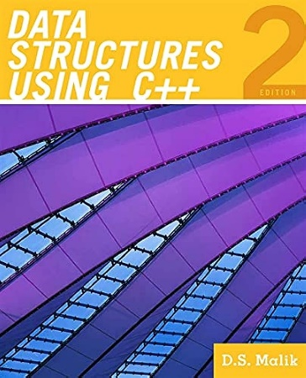
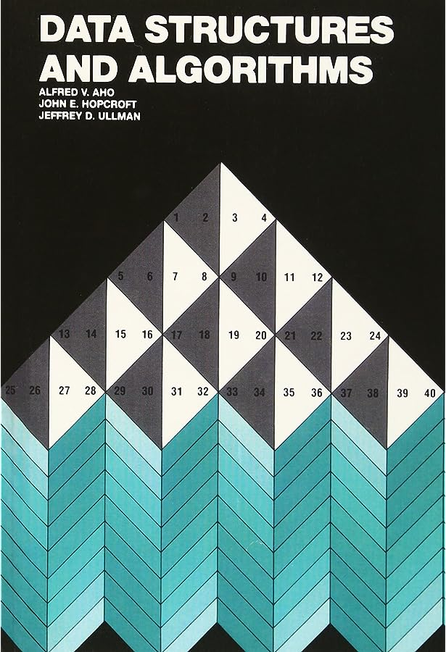
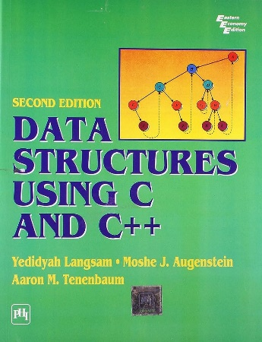
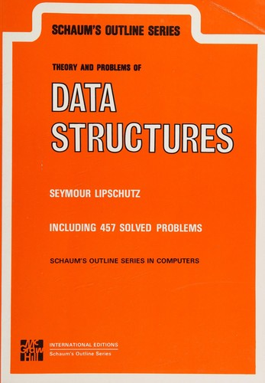
Thank You All
☺
?
A note on the origin of these ppt slides: Thanks to Dr. Zainab FAST-NUCES, ISB and Douglas Wilhelm Harder, M.Math. LEL Department of Electrical and Computer Engineering University of Waterloo Waterloo, Ontario, Canada, I have adopted my slides from their slides.

